Slide 1

History and
Physical examination
Dr. Achalu (MD, Pediatrician)

Slide 2
General principle
  Greet your patient/caretaker by name.
  Introduce yourself
  Show courtesy
  Secure privacy
  Use words that the care taker can understand
  Take rough notes w/h can then be re-written
    Do not act as if you are a clerk in the court

Slide 3
General Principles
  Describe in the words of the patient instead of using technical terms.
  Put questions as open-ended
    It allows the patient/care taker to talk about what they want to.
  Give adequate time for the care taker to think & reply.
    Never interrupt

Slide 4
  Explain your finding to the patient/care taker.
    Do not give a premature Dx
    Do not give a false information or false reassurance
  Involve the patient in your plan.
  Take reasonable time to interview.
  Close the interview by thanking

Slide 5
Contents of pediatric Hx
Personal Identification
Previous admission
Chief complaints
History of present illness
Past medical Hx
Family Hx
Perinatal hx
Immunization Hx
Nutritional Hx
Developmental Hx &
Review of systems

Slide 6
Identification/Personal details:
  Name
  Age:
  Gender:
  Address:
  Religion:
  Parents’ name, age & occupation
Historian
  Mother
  Father
  Any other relative or care taker
    with description of extent of relation with the patient.

Slide 7
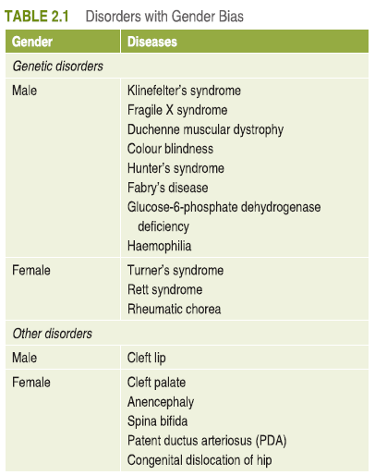
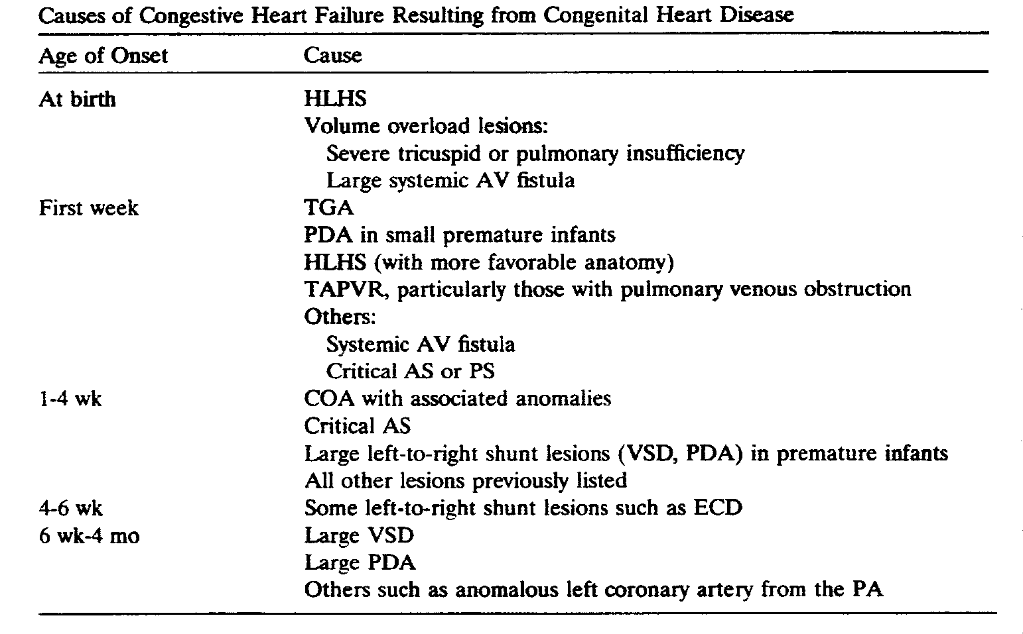

Slide 8
Previous admission
Hospital admissions with clear description of location, time, reason & outcome.
Chronological order

Slide 9
Chief complaint
  Should hold the main reason to seek medical advice.
  Should be written in the words of the patient.
  chronological order of their appearance
  Complaint + duration

Slide 10
History of present illness
  Elaborates C/C With:
    emphasis on the genesis of the illness & associated Sxs.
  The details of the C/C should include:
    Mode of onset: insidious/sudden
    Elaboration of symptoms &
    Relevant questions about positive negative statements
    Chronology of symptoms

Slide 11
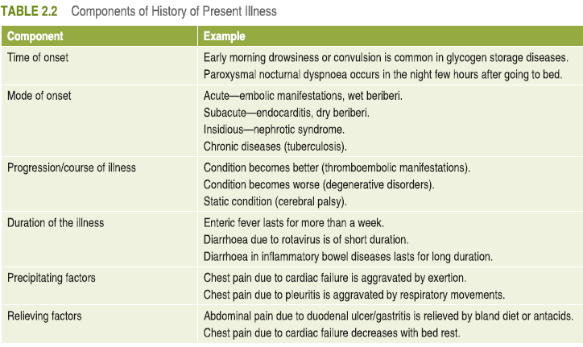

Slide 12
  Other Hx
    Past medical illness
    Perinatal history
      Antenatal, natal, postnatal
    Nutrition
    Immunization
    Growth & development
    Personal and social hx
    Family Hx

Slide 13
NUTRITIONAL HISTORY
Time Breast feeding initiated (immediately after birth or later)
Duration of Exclusive Breast feeding
Total duration of Breast feeding,
Weaning age,
type of weaning diet, solid or liquid, how prepared, amounts given, number of meals per day.
Food after weaning: milk, other fluids, solid food, appetite, etc.
  Present diet: Type, amount, and frequency.
  Sunshine Exposure: how long, how.

Slide 14
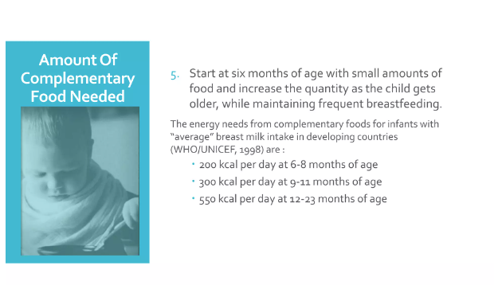

Slide 15
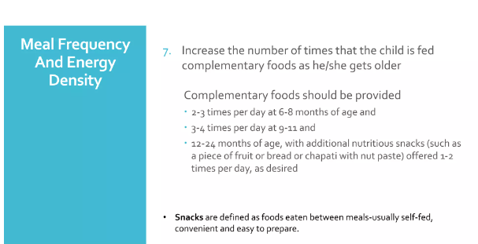

Slide 16
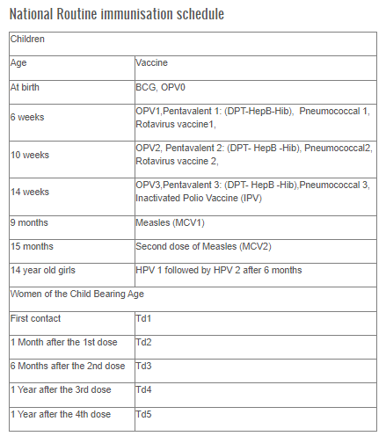

Slide 17
Growth and development
Gross motor
Fine motor
Language
Cognitive
social-emotional and behavioral

Slide 18
age | Milestones
1 mth | Raises head slightly when prone; alerts to sound; regards face; moves extremities equally
2-3 mths | Smiles, holds head up, coos, reaches for familiar objects, recognizes parents
4-5 mths | Rolls front to back & back to front; sits well when propped; laughs, orients to voice; enjoys looking around
6 mths | Sits unsupported; passes cube hand to hand; babbles
8-9 mths | Crawls; pulls to stand; pincer grasp; feeds self with bottle
12 mths | Walking, talking a few words, understands NO; says mama/dada
15-18 mths | Comes when called; walks backward; uses 4 -20 words, builds tower of 2 blocks.
24-30 mths | Removes shoes; follows 2 step command; jumps with both feet; points to body parts; runs; spoon feeds self
3 years | Dresses & undresses; walks up & down steps; draws a circle; knows more than 250 words; takes turns; shares group play.
4 years | Hops; skips; catches ball; memorizes songs; knows colors; use pleural
5 years | Jumps over objects; prints first name; knows address & mother name; follows game rules; draws 3 part man; hops on one foot

Slide 19
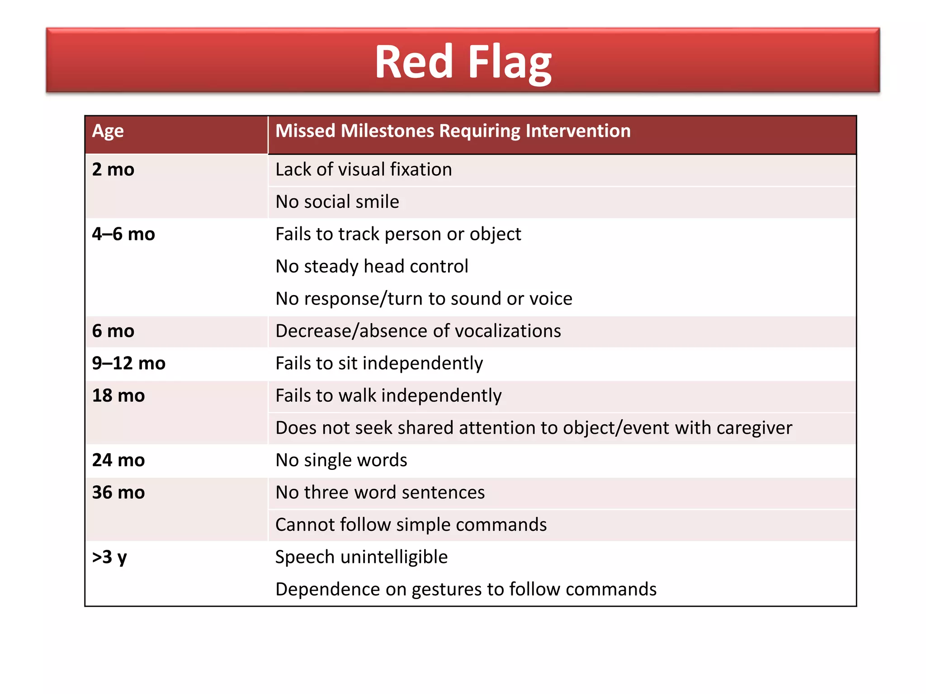

Slide 20
Past medical Hx:
  Past childhood illnesses
  Major chronic illnesses
  Surgical procedures
  Accidents – time & sequela

Slide 21
Review of systems:

Slide 22
Physical examination

Slide 23
Physical examination
General appearance:
  Status of health
  Level of consciousness
  Sign of respiratory distress
  Nutritional status
  Dysmorphic feature

Slide 24
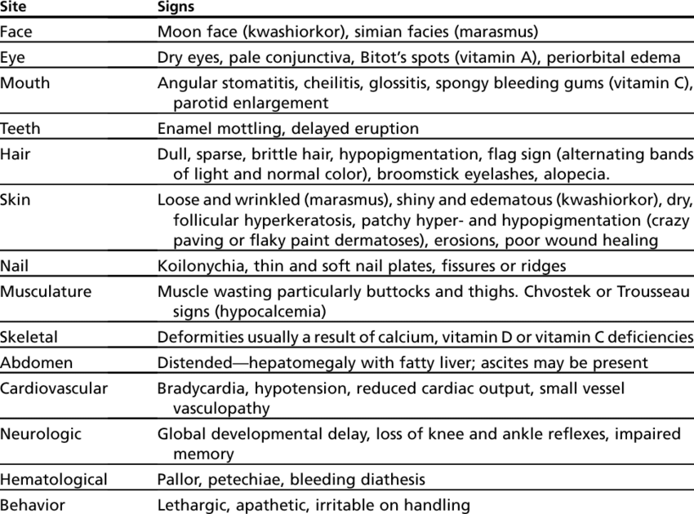

Slide 25
Vital sign
  BP
  PR
  RR
  Tº
  Pain score

Slide 26
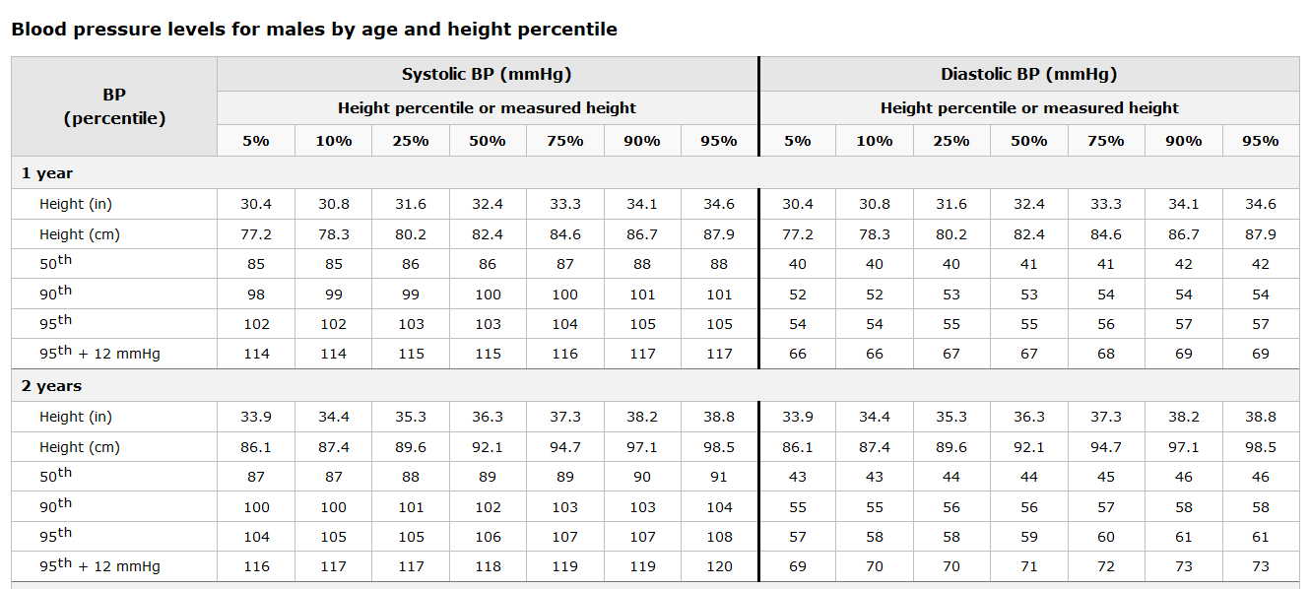

Slide 27
Anthropometry
  Height/length
  Weight
  Head circumference
  Mid upper arm circumference

Slide 28
Weight-for-height:
    Reflects recent weight loss or gain.
    Best indicator of wasting & so is the indicator for acute malnutrition.
Height-for-age:
    Reflects skeletal growth, best indicator for stunting.
    Used to determine chronic malnutrition.

Slide 29
    Weight-for-age:
      A composite indicator.
      Reflects either wasting or stunting or both.
      Rapidly changing WFA can be assumed to be the result of changing WFH
      This indicator is used for determining underweight.

Slide 30
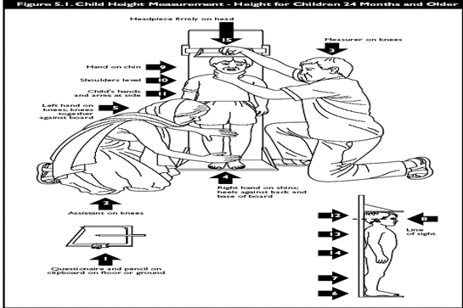
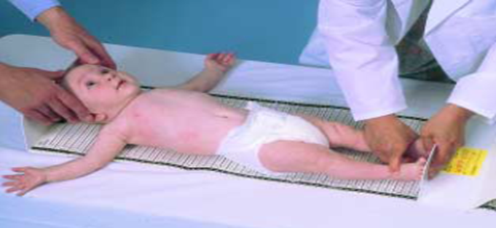

Slide 31
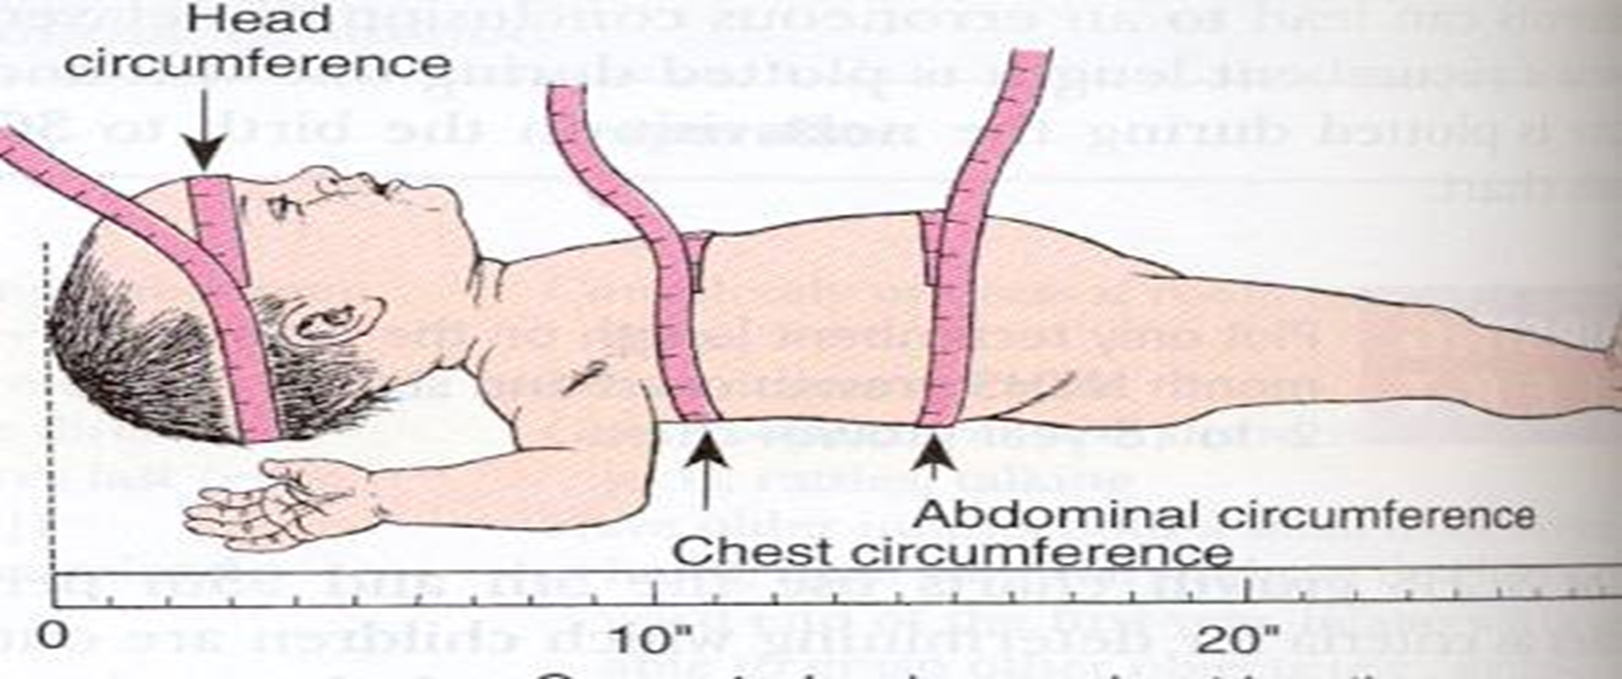

Slide 32
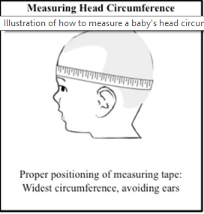

Slide 33
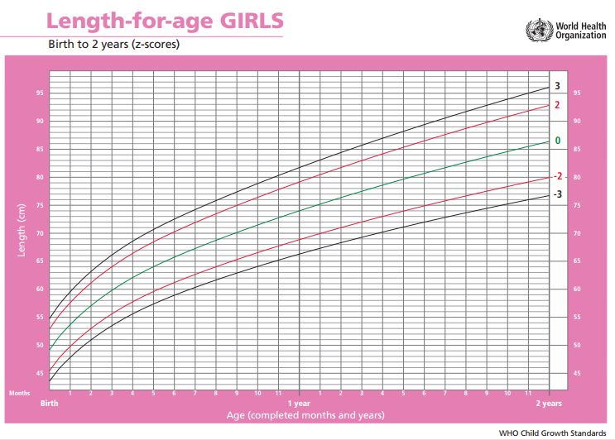

Slide 34
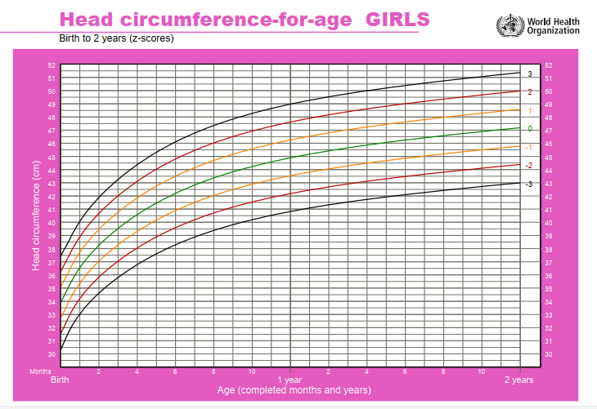

Slide 35
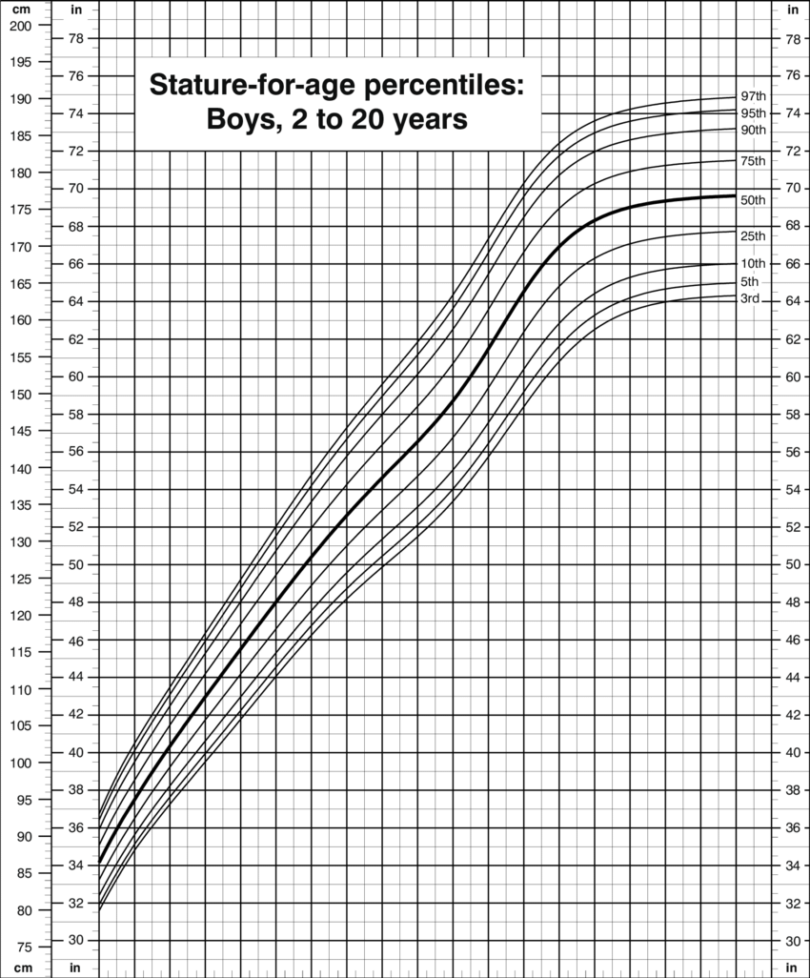

Slide 36
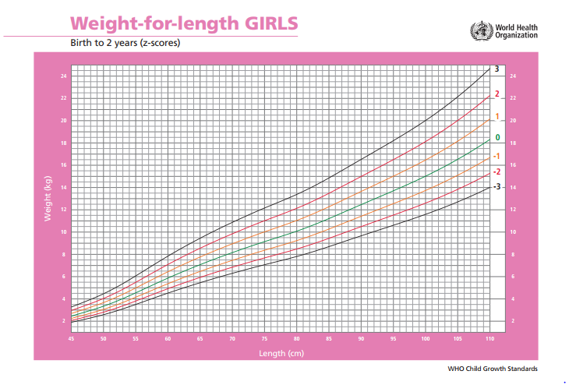

Slide 37
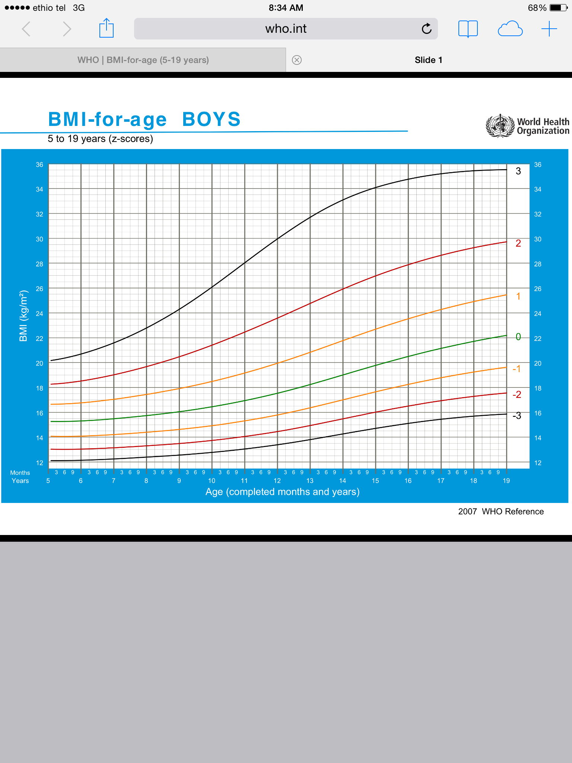

Slide 38
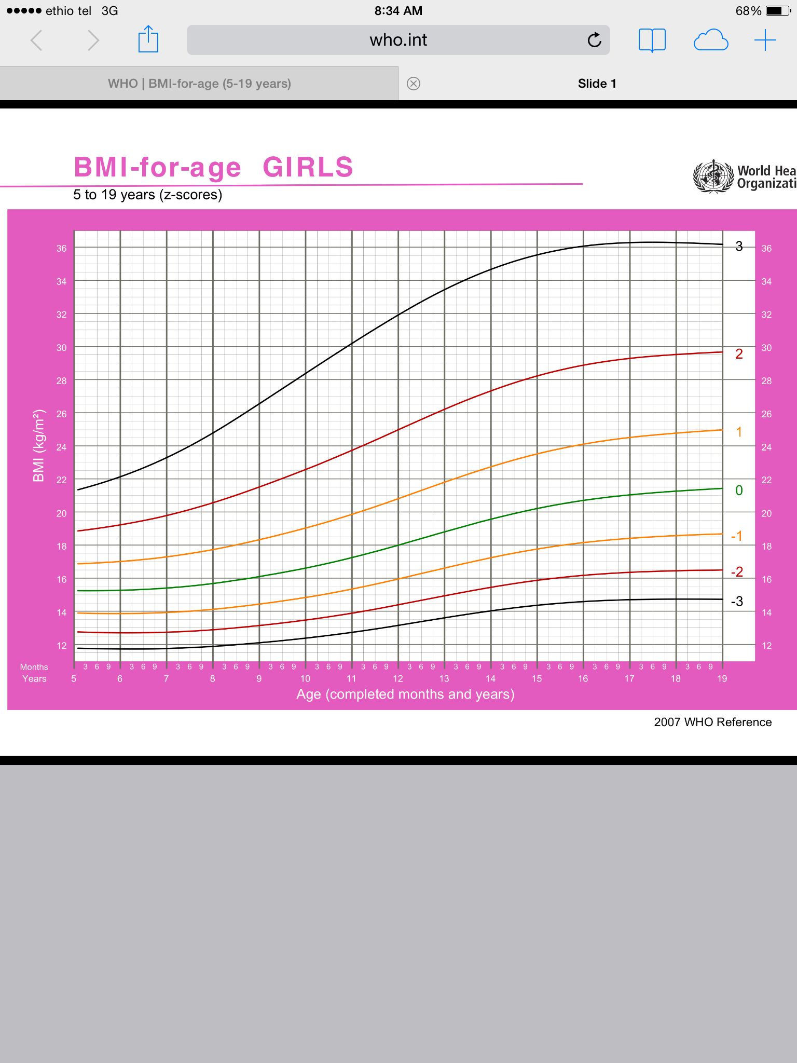

Slide 39
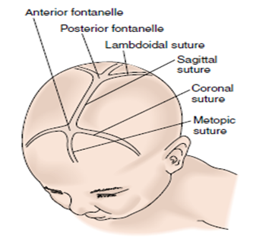
HEENT
Head:
  Appearance or shape
  Area of swelling, scars, tenderness
  Hair:
    Distribution, texture, pluckability, color,
  Fontanel: depression, size, closure

Slide 40
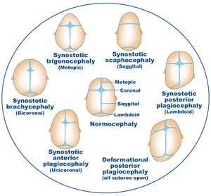

Slide 41
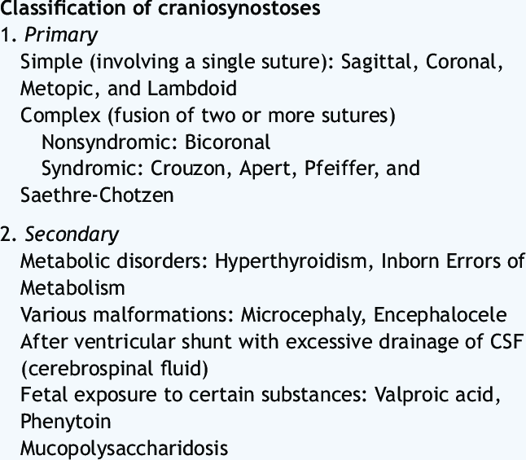
Early fontanel closure

Slide 42
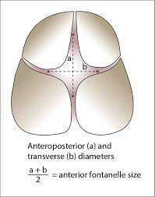
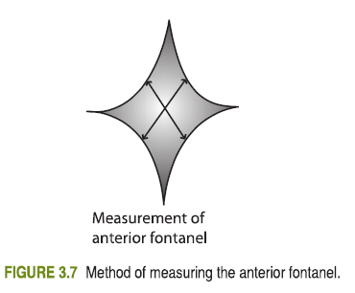

Slide 43
Delayed fontanel closure
Achondroplasia
Down's syndrome
Congenital hypothyroidism
Rickets
Hydrocephalus
Congenital syphilis
Congenital rubella syndrome
Osteogenesis imperfecta
Preterm infants
Russell-Silver syndrome
Skeletal dysplasia
Thalasaemia major
Trisomy 13
Trisomy 18
Apert’ s syndrome
Cleidocranial dysostosis
Cutis laxa
Ligamentous laxity
Delayed development syndrome
Hypophosphatasia

Slide 44
Eye
Spacing
Eye lid and eye lashes
Position and Size of the Eyeballs
Conjunctiva
Sclera
Iris
Pupil

Slide 45
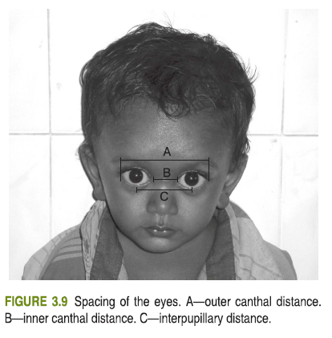
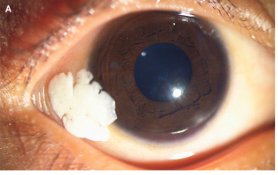
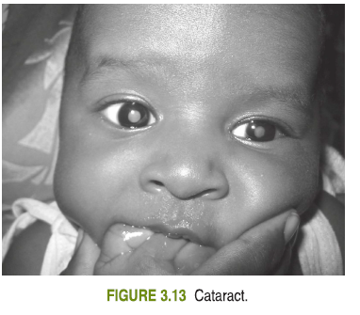
Inter canthal index:- 33-38
IPD:-40

Slide 46
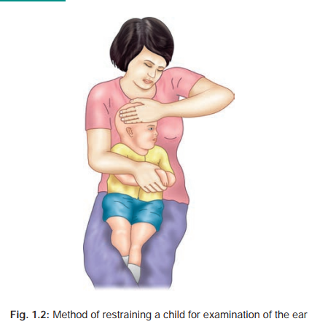
Ears :
  Pinnae abnormalities
  External ears : signs of inflammation
  Otoscopic examination:

Slide 47
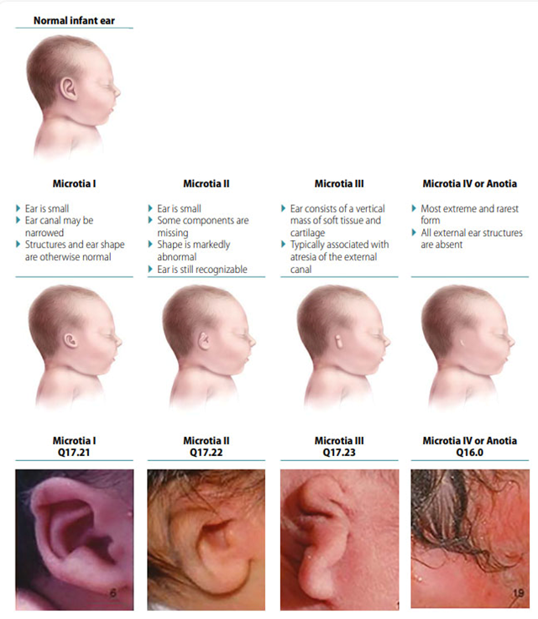
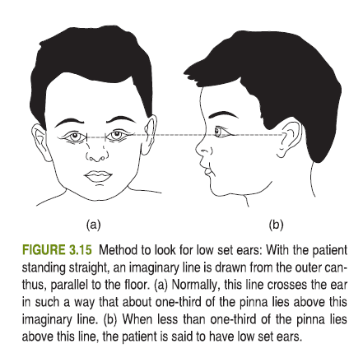

Slide 48
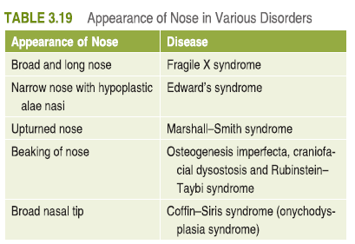
Nose:
  Shape,
  septum,
  discharge, mass,
  smelling ability

Slide 49
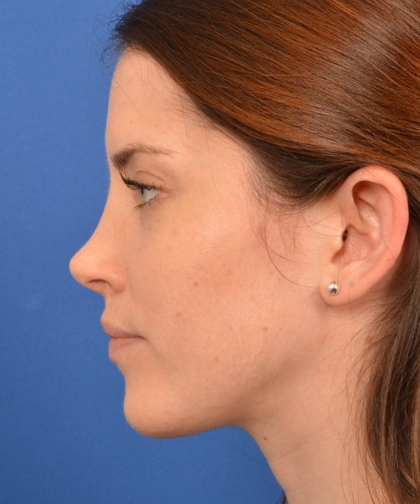
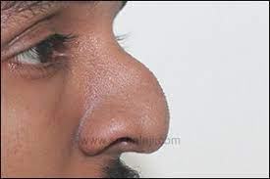
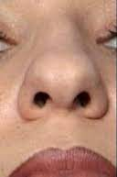

Slide 50
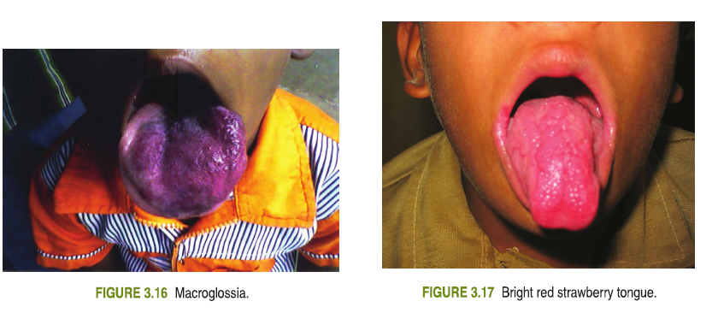
Mouth & throat:-
  Lip :- cyanosis, cleft lip,
  Tongue :-thrush, dryness
  Mucous membranes :- thrush, dryness …..

Slide 51
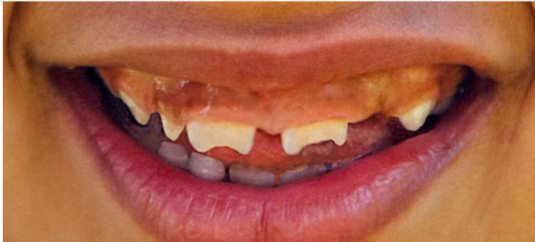
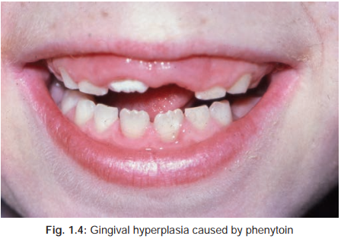
  Teeth :-
    Color
    shape
    carries,
    gum hypertrophy,
    number of teeth
  Throat :-
    Tonsils, uvula, pharynx

Slide 52
NECK
Length of the neck
Webbing of neck
Swellings
Torticollis
Neck rigidity
laxity of skin
Length
  A=determine length of child
  B =distance between the external occipital protuberance and C 7 vertebra
  B/A< 13 …… normal
  B/A>14 …… short neck

Slide 53
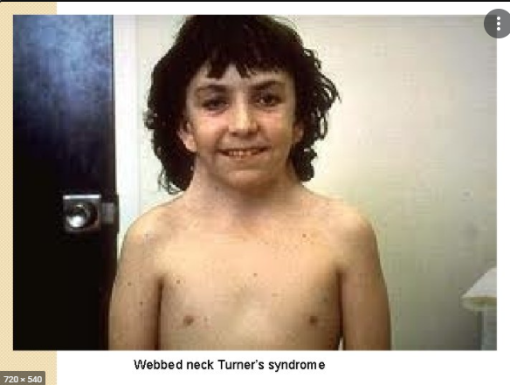
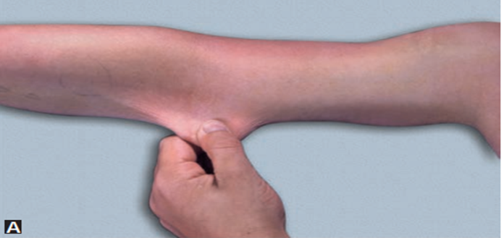

Slide 54
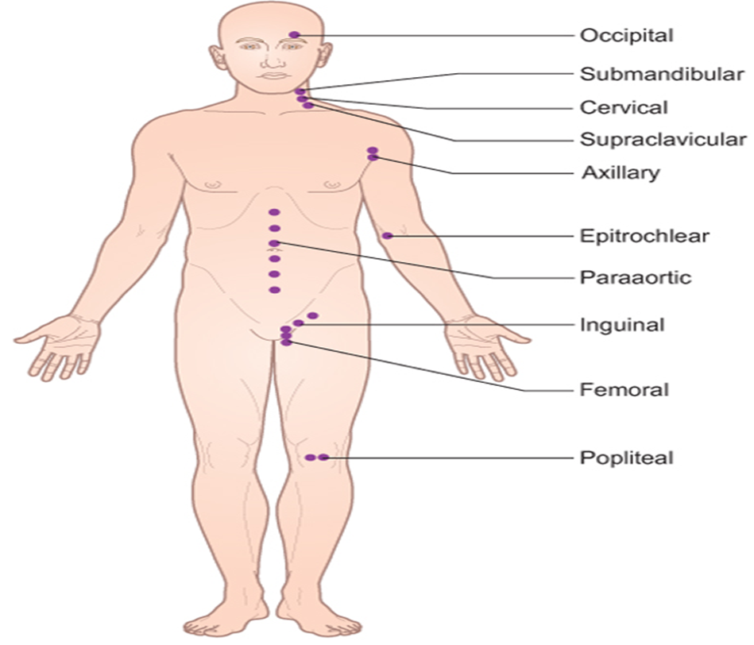
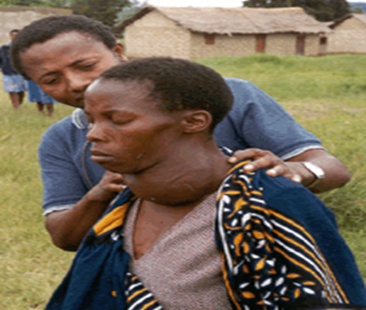
Lymphoglandular system
Lymph node
Breast
Testis
Thyroid

Slide 55
Respiratory system
Inspection:-
  Sign of RD
  Chest deformity
  Clubbing
  Pattern of breathing
  Listen for audible sounds
Palpation:-
  Tracheal position
  Tactile fremitus
  Tenderness
  Chest expansion

Slide 56
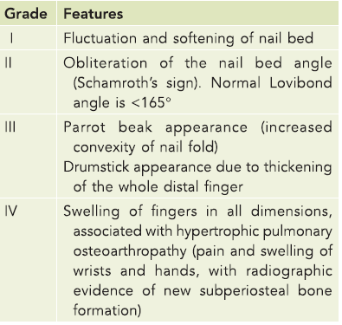
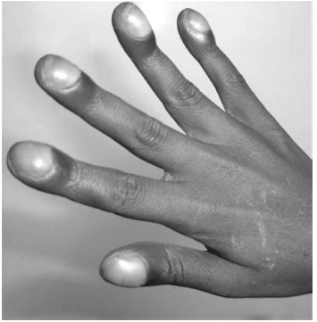

Slide 57
Respiratory system …..
Percussion:-
  Resonant
  Hyper-resonant
  Dull
    Relative
    Stony
Auscultation:-
  Breath sound
  Air entry
  Added sound
  Adventitious sound

Slide 58
Cardiovascular system
  Inspecting for cyanosis, clubbing & pallor
  Examination of the arterial & venous system
  Examination of the precordium

Slide 59
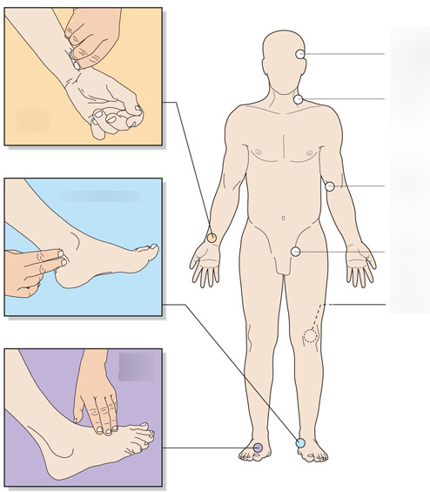
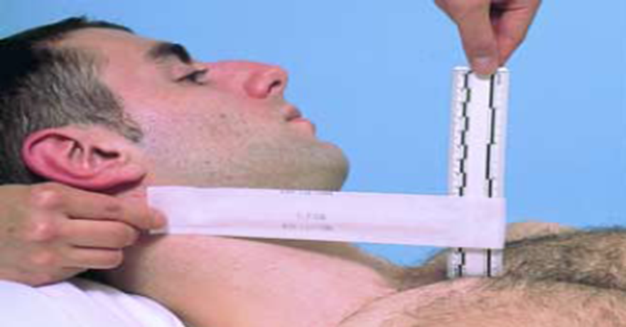
CVS……..

Slide 60
CVS…………. Precordium:-
Inspection:
  Activity of the precordium
    Hyperdynamic, silent….
  Any shape abnormality
    Bulging…….
  Apical impulse
  Palpation:
    PMI
    thrill
    heave
    Check for palpable P₂ at the pulmonic area

Slide 61
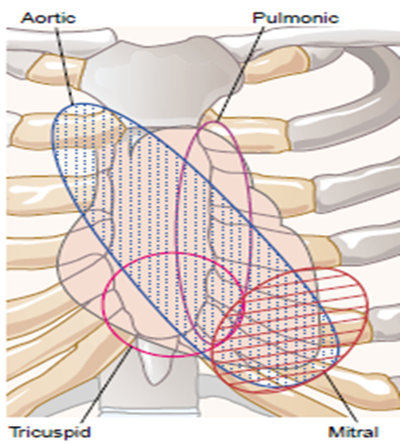
CVS…….. auscultation
Assess the rate & rhythm
Murmur
Gallop
Splitting heart sound

Slide 62
CVS…….. auscultation
Murmur characterization
  Duration
  Pitch
  Grade
  Intensity
  Location
  Radiation
Grade I : barely audible in quiet room.
Grade II: quiet but clearly audible
Grade III: loud, no thrill
Grade IV: loud, associated with thrill
Grade V: very loud, audible with partial elevation of stethoscope
Grade VI: very loud, audible with stethoscope not in contact with chest

Slide 63
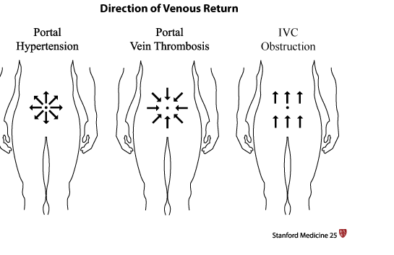
Abdominal examination
Inspection:
  Hernial site
  Appearance:-
    Scaphoid, distended, full
    umbilicus,
    Flank
    Movement with respiration
  Scar
  Distended vein

Slide 64
Abdominal examination ………….
Palpation
  Superficial palpation:
    To check for tenderness & mass
  Deep palpation:
      Mass at all quadrants
      For liver & spleen
Percussion:
  Normally tympanic
  Check for fluid thrill
  Check for shifting dullness:
  Check for total liver span:

Slide 65
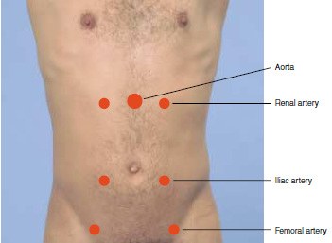
Abdominal examination ………….
Auscultation:
  For bowel sounds
  For bruit around great vessels
DRE

Slide 66
Genitourinary system
Inspect
  Suprapubic area
  Inspect external genitalia area
  Urethral opening of penis
  If female
    fb
    Labia fusion
    Hymen
Palpation:
  Kidney palpation
  Suprapubic palpation
  Scrotum palpation
SMR

Slide 67
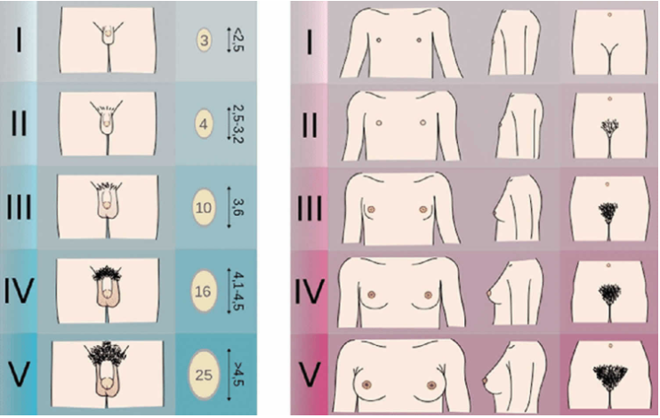

Slide 68
MSS
LOOK
  deformity
  muscle size
  Swelling
  Gait
FEEL
  Warm
  Tenderness
Move
  Extent of mobility

Slide 69
Integumentary system
Skin
Hair
Nail

Slide 70
Skin: should be assessed for its
  Color – jaundice, pallor, cyanosis, hyper/hypopigmentation
  Moisture – wetness, dryness, oiliness
  Temperature – fever, cold
  Turgor – classification
    Skin pinch goes back quickly
    Skin pinch goes back slowly
    Skin pinch goes back very slowly : > 2 seconds

Slide 71
CNS
Mental status
  Level of consciousness
    Alert
    lethargic
    Obtunded
    Stupor
    Coma
  GCS

Slide 72
CRANIAL NERVES

Slide 73
MOTOR EXAMINATION
  Muscle bulk
  Tone
  power
Muscle power
  Grade 0 – no movement at all
  Grade 1 – flickering movement at joints
  Grade 2 – moves extremities but not against gravity
  Grade 3 – moves against gravity
  Grade 4 – moves against minimal resistance
  Grade 5 – normal movement.

Slide 74
Reflex
  Superficial reflex
  DTR
SENSATION
  Touch
  Pain
  Temperature
  vibration

Slide 75
Meningeal sign
  Neck stiffness
  Brudzinski sign
  Kerning sign

Slide 76
Thank you

